Slide 1
Robotics and IoT Club Secondary Years Level 2 - Week 12
Roohi Banu

Slide 2
Journey so far….

Slide 3
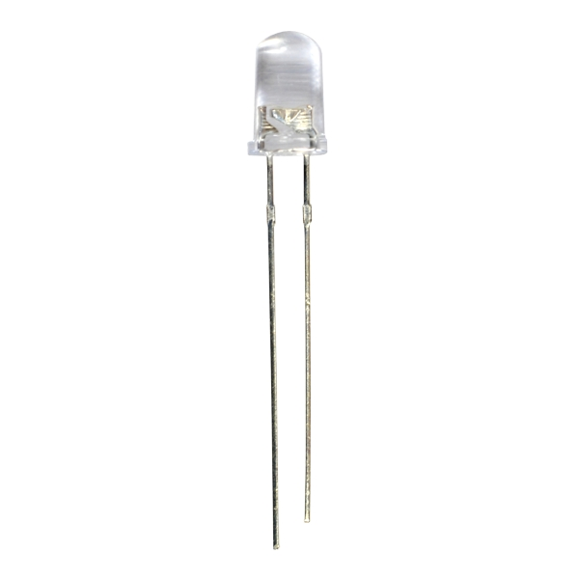
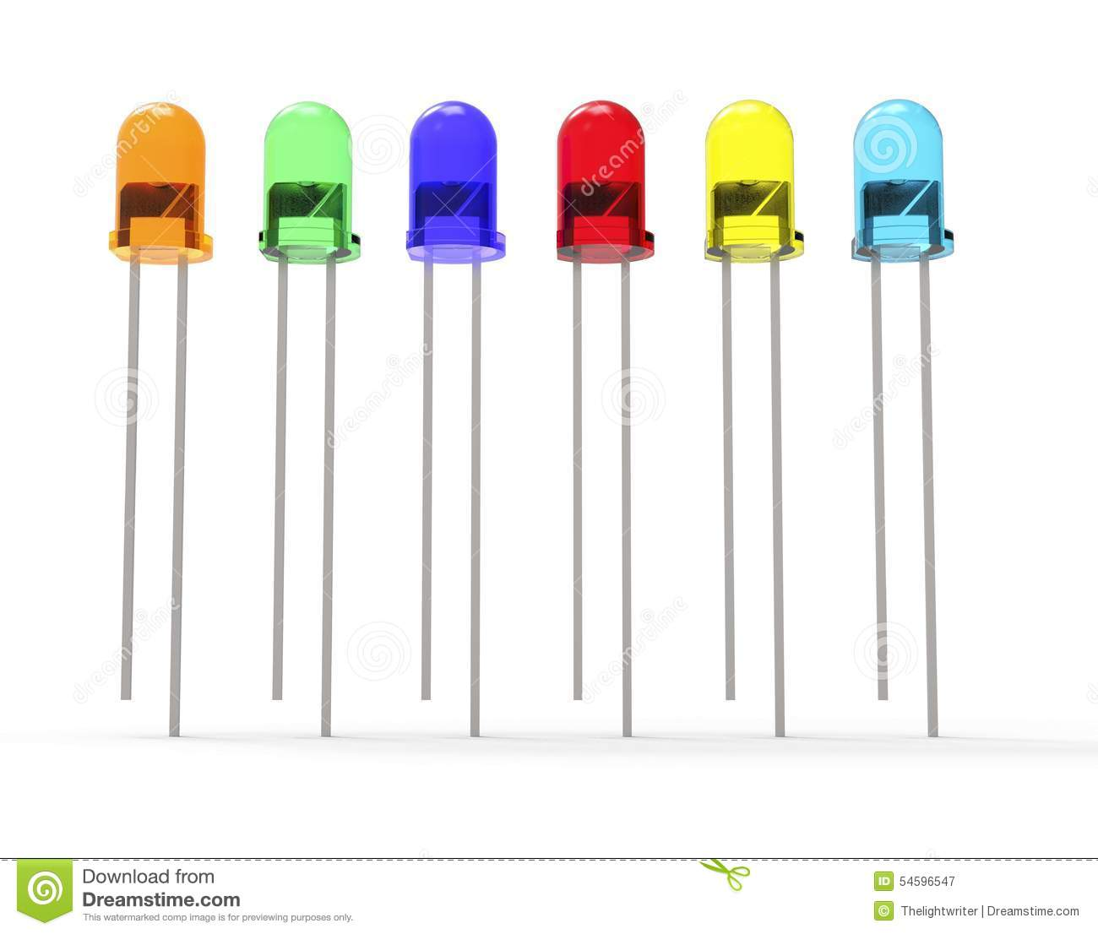
Basic Electronic Components
What is a LED?
Light
Emitting
Diode
LED has one Long leg and one short leg
Short Leg Negative ‘-’
Long Leg Positive ‘+’

Slide 4


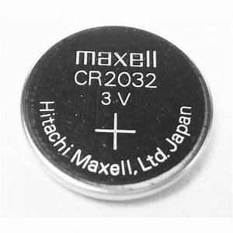
Basic Electronic Components
What is a Battery?
Positive ‘+’
Positive ‘+’
Positive ‘+’
Negative ‘-’
Negative ‘-’
Negative ‘-’

Slide 5
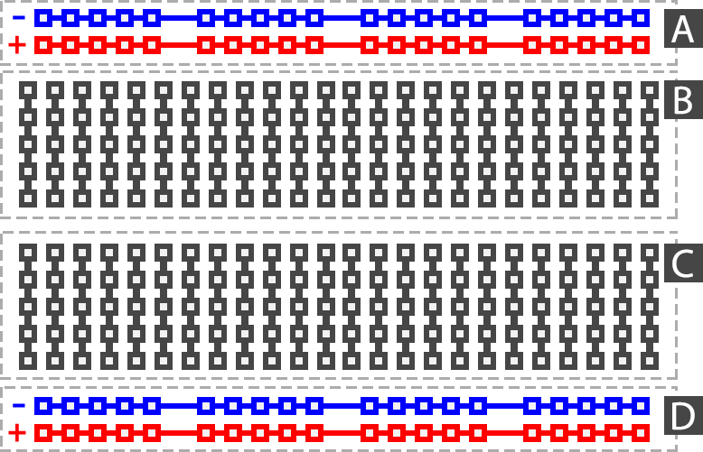
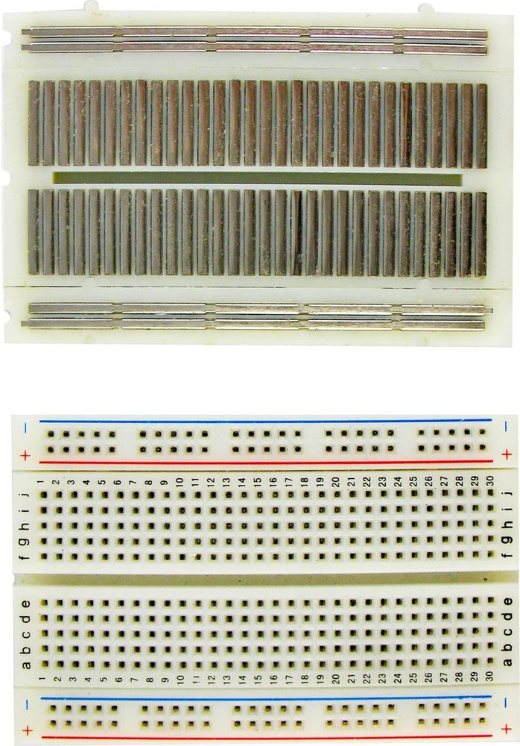
Bread Board
Row
Column

Slide 6
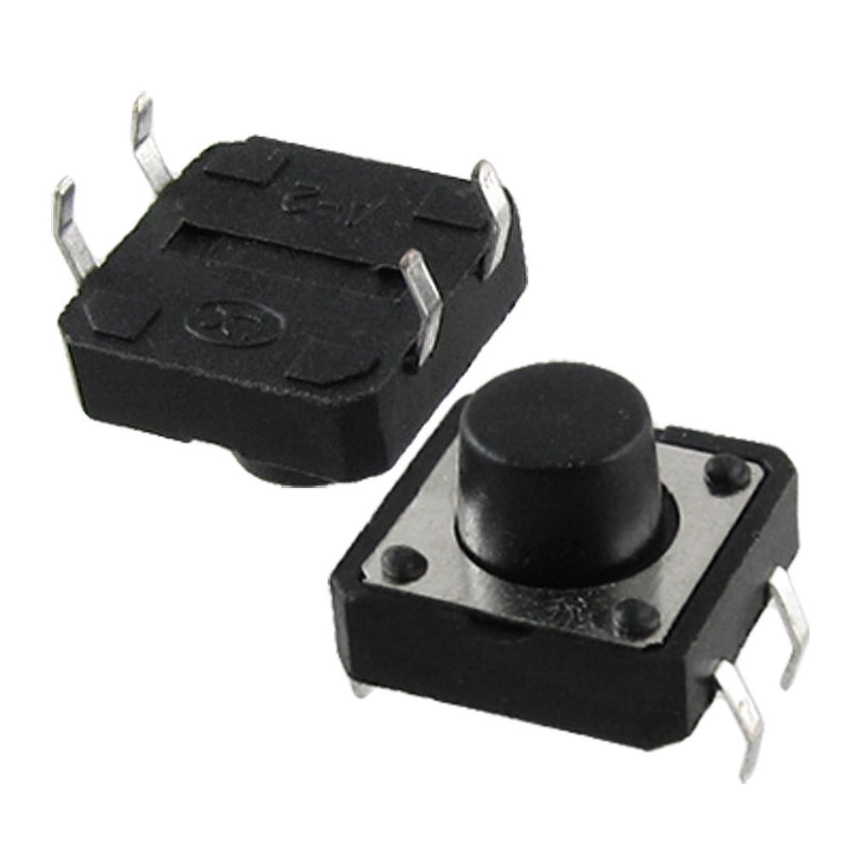
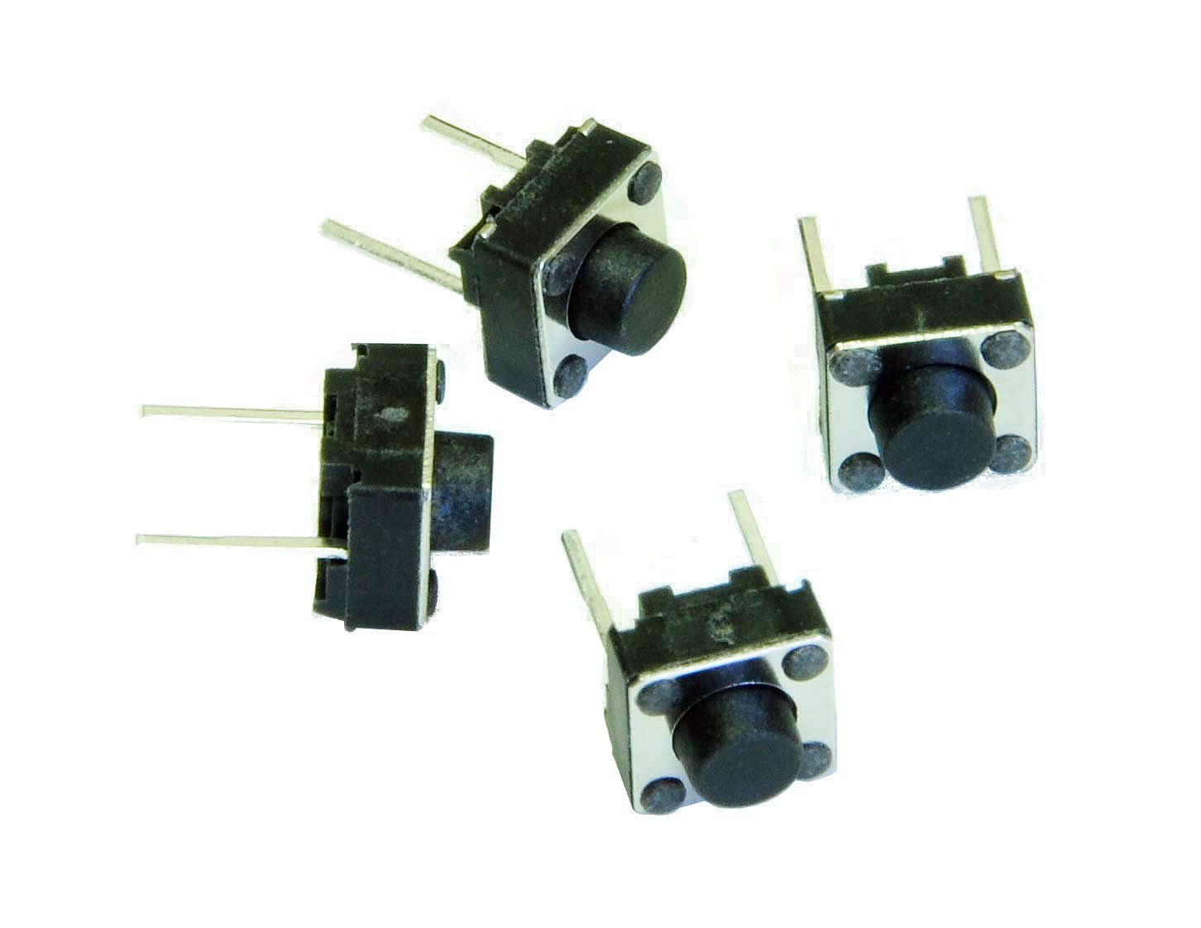
Switch

Slide 7
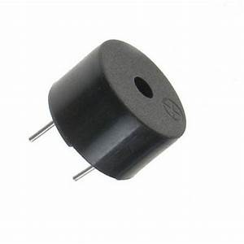
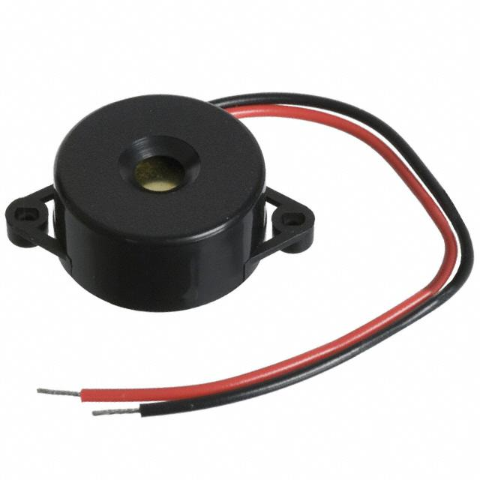
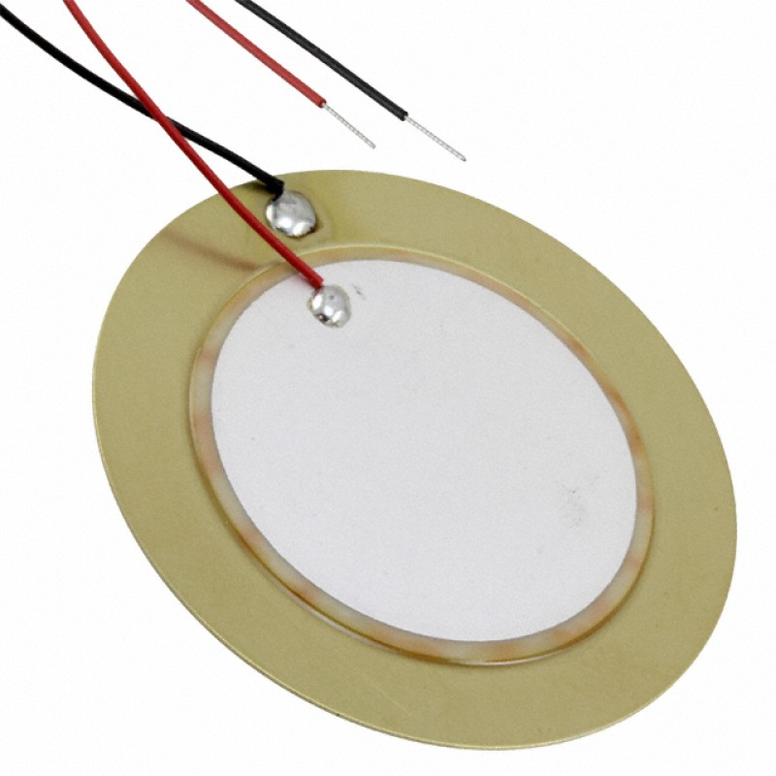
Buzzer
Positive
Negative
Negative
Positive
Positive
Negative

Slide 8
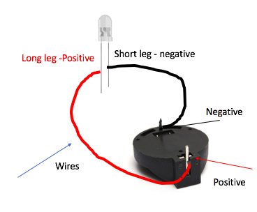
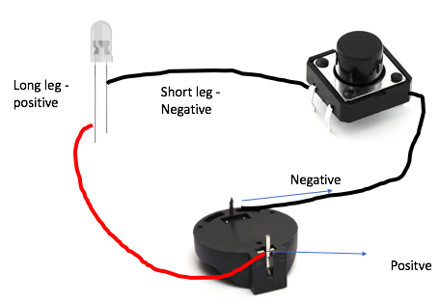
We started with ….
Bread board
LEDs
Buzzers
Button
Connecting wires
Batteries

Slide 9
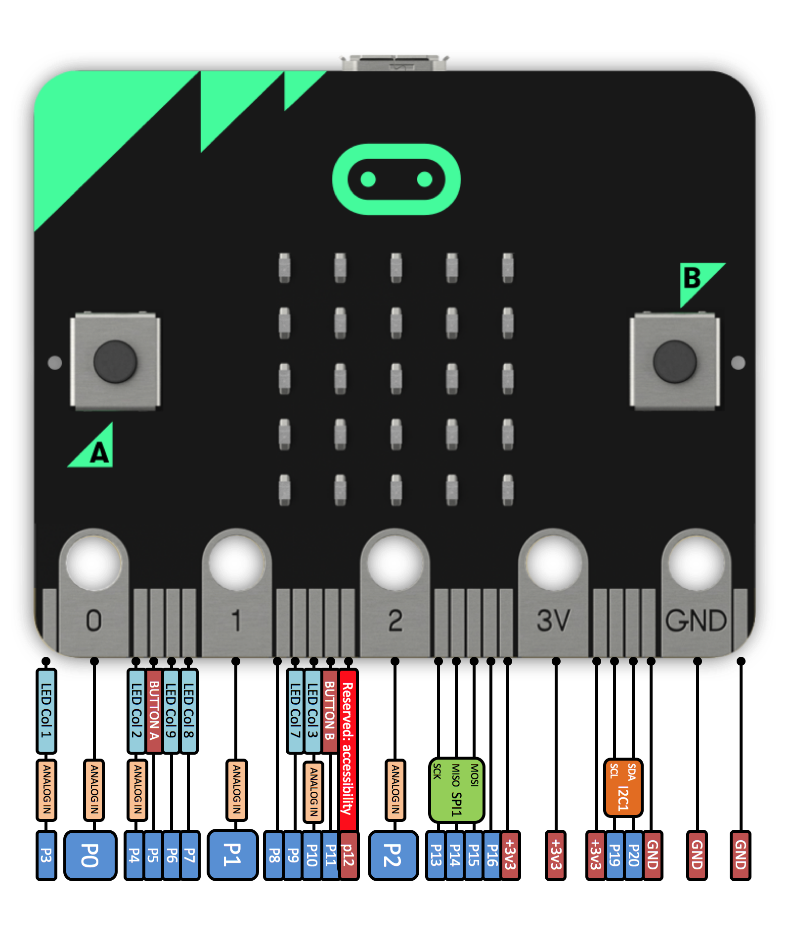
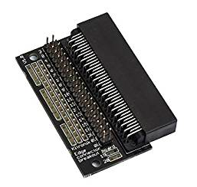
BBC Microbit Pins
https://microbit.org/guide/hardware/pins/

Slide 10
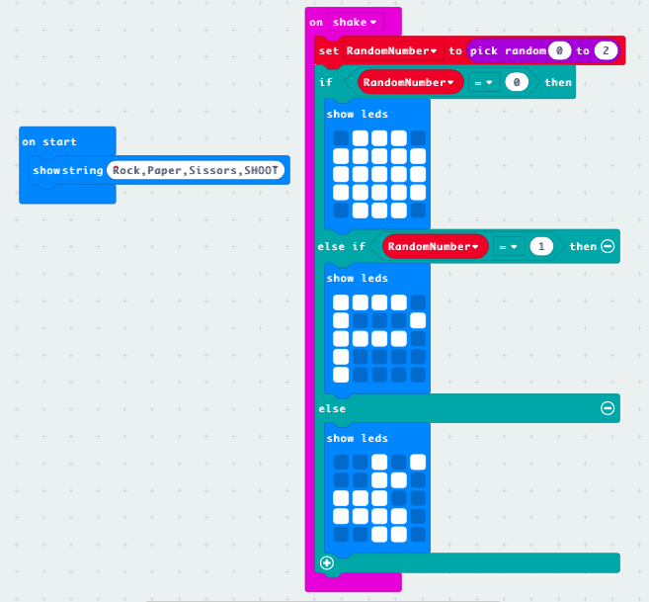
Challenge: Rock, Paper, Scissors

Slide 11
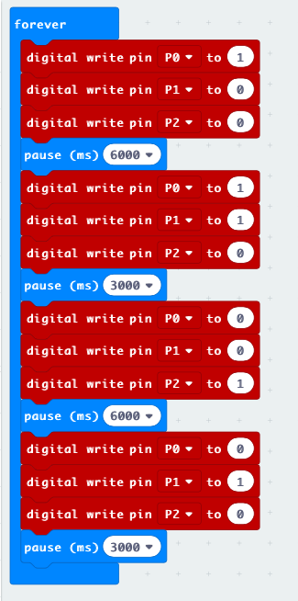
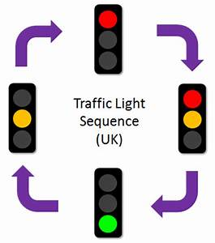
Traffic Lights
Longer Pause
Shorter Pause
Shorter Pause
Longer Pause

Slide 12
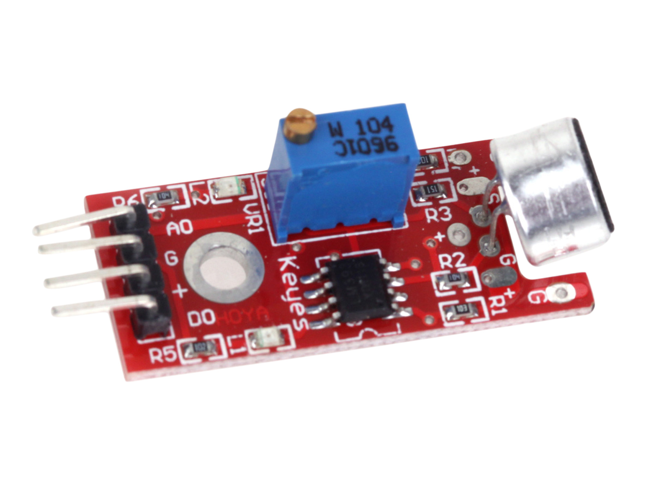
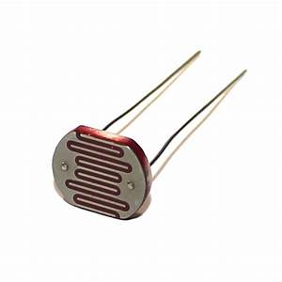
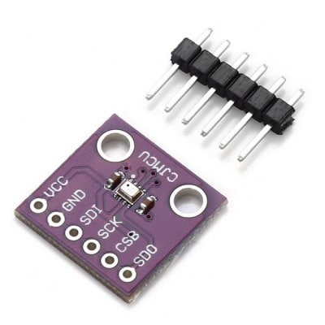
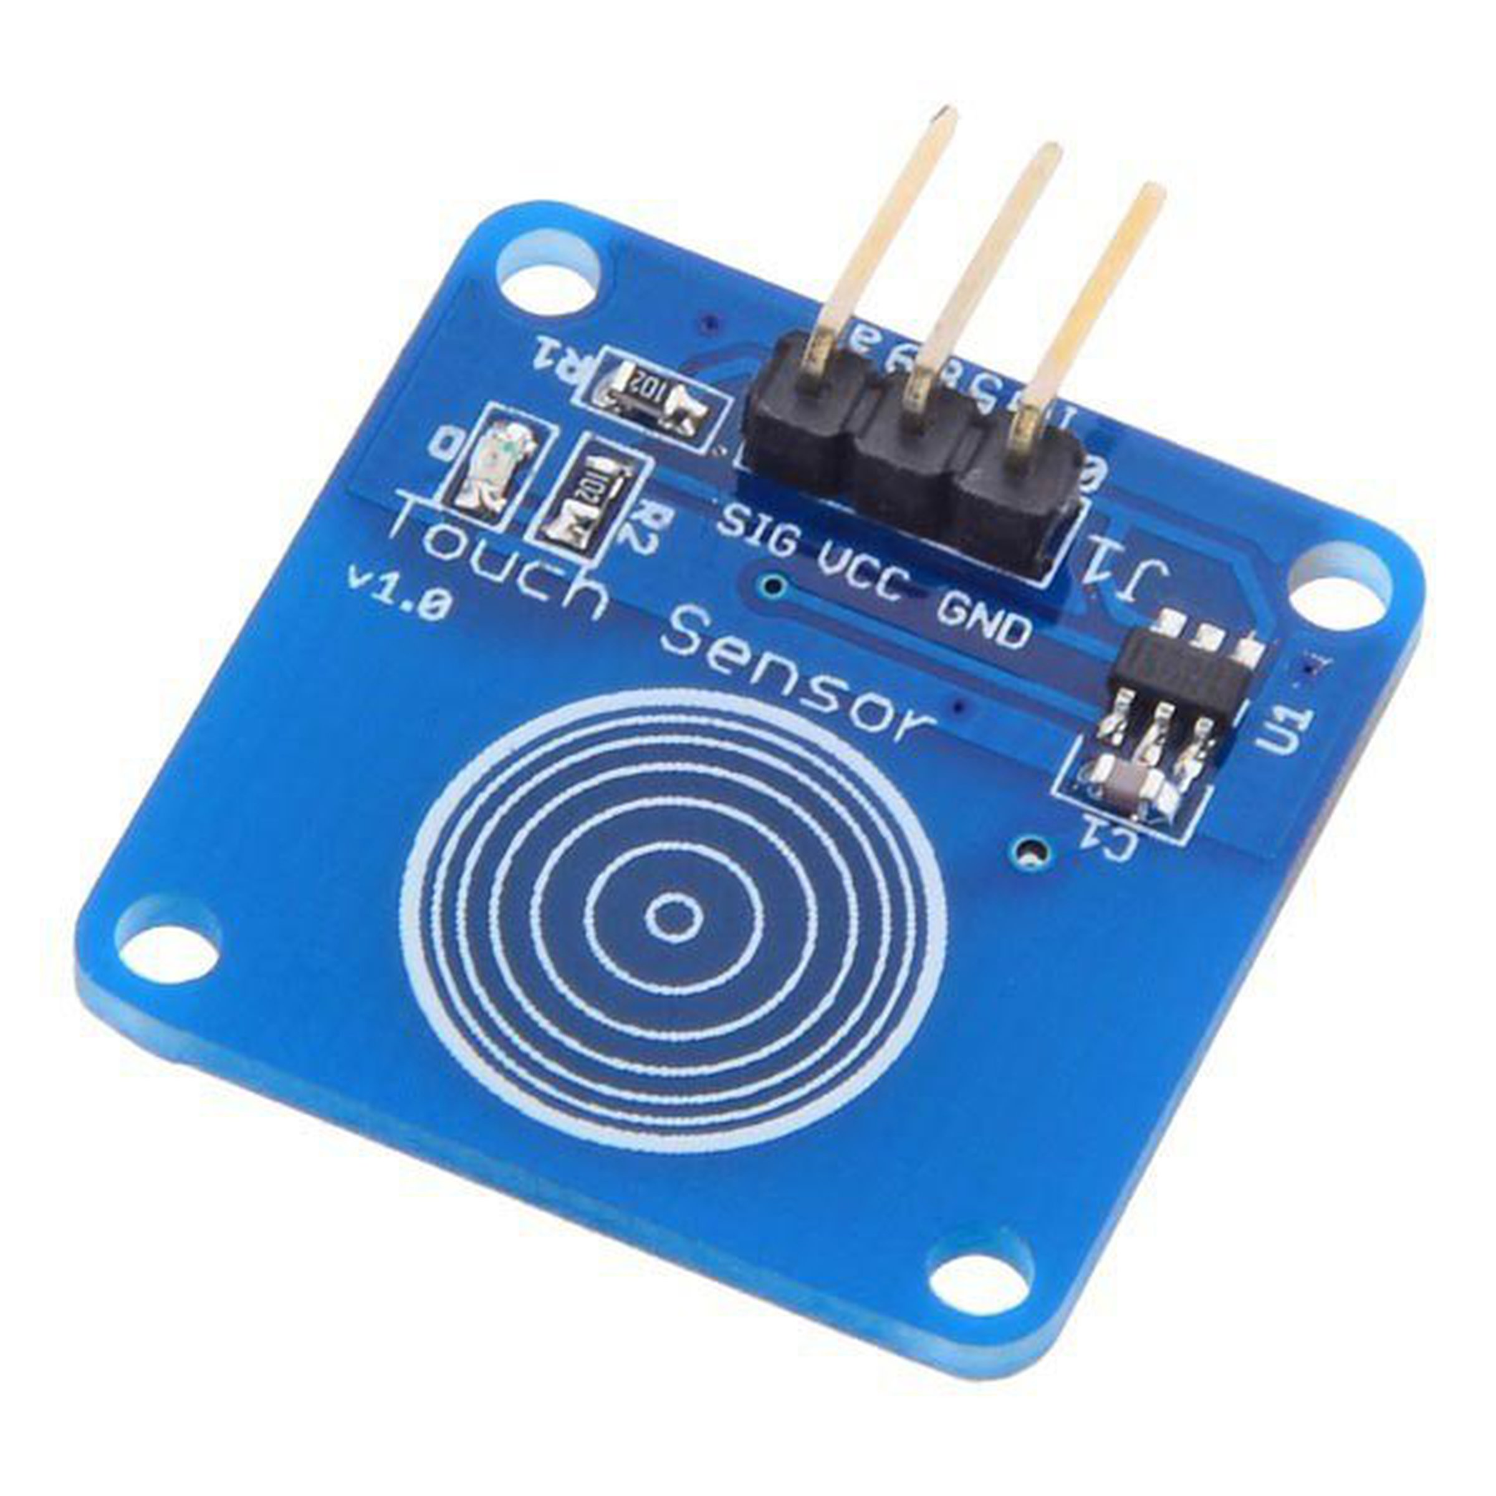
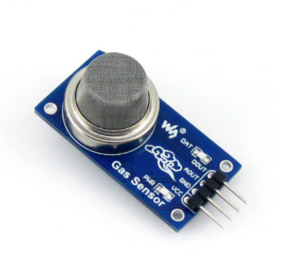
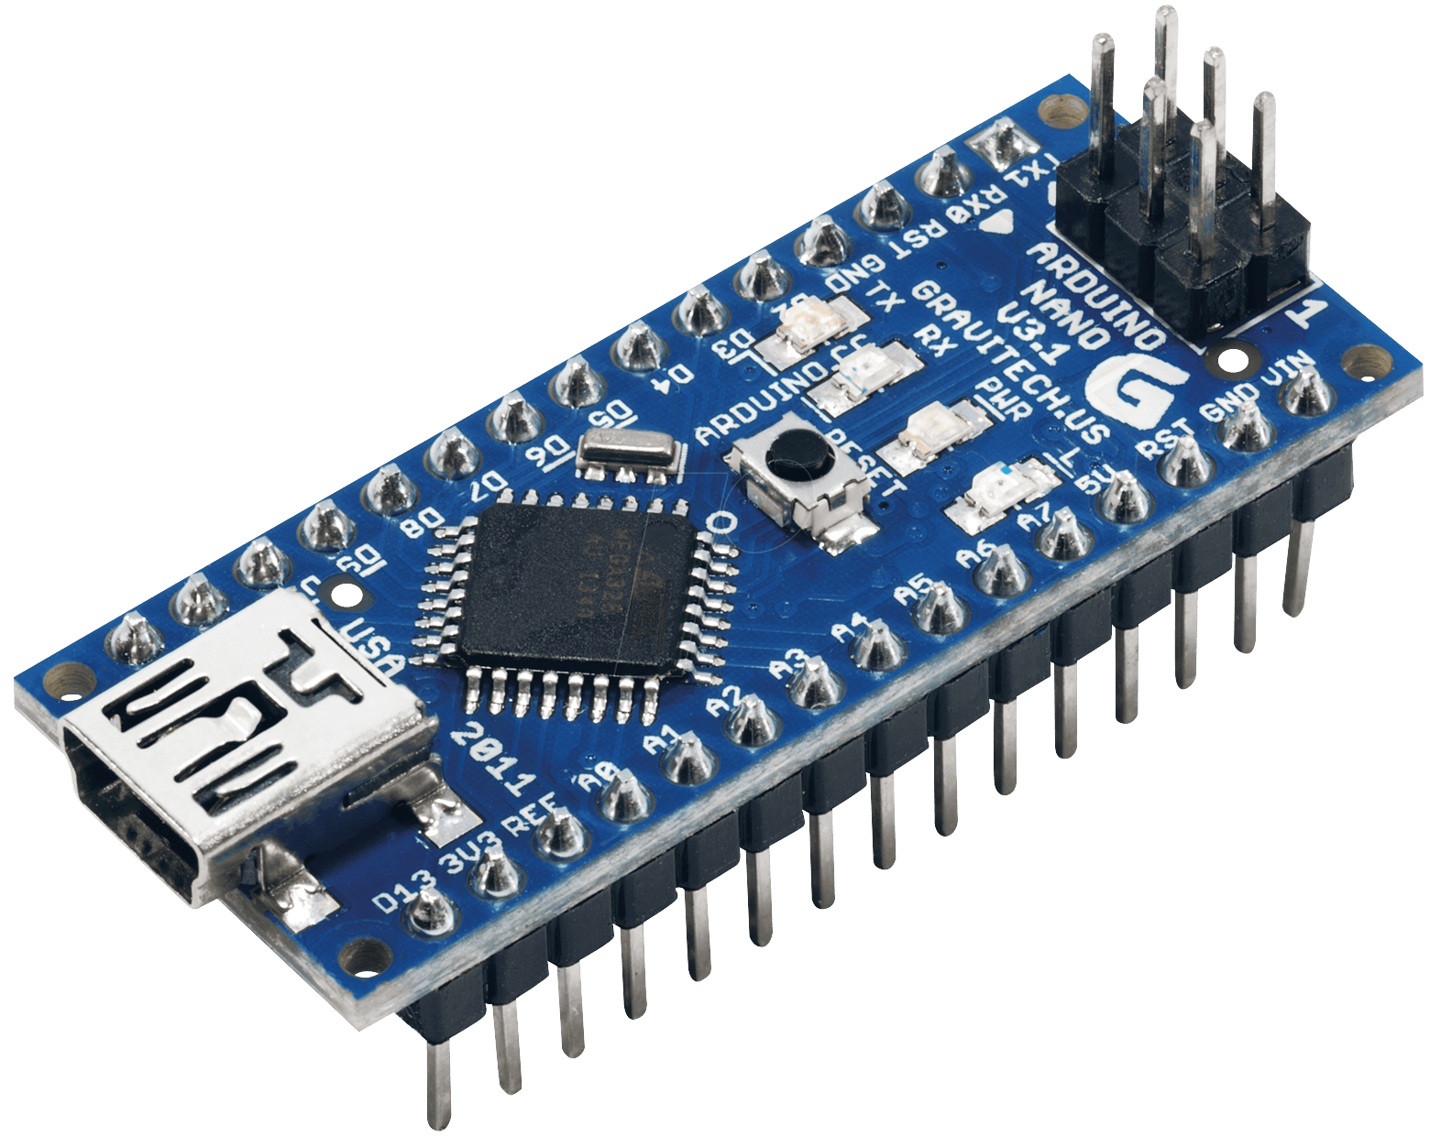
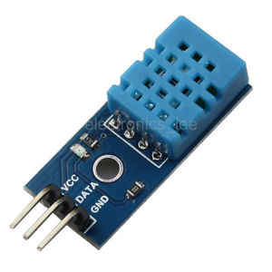
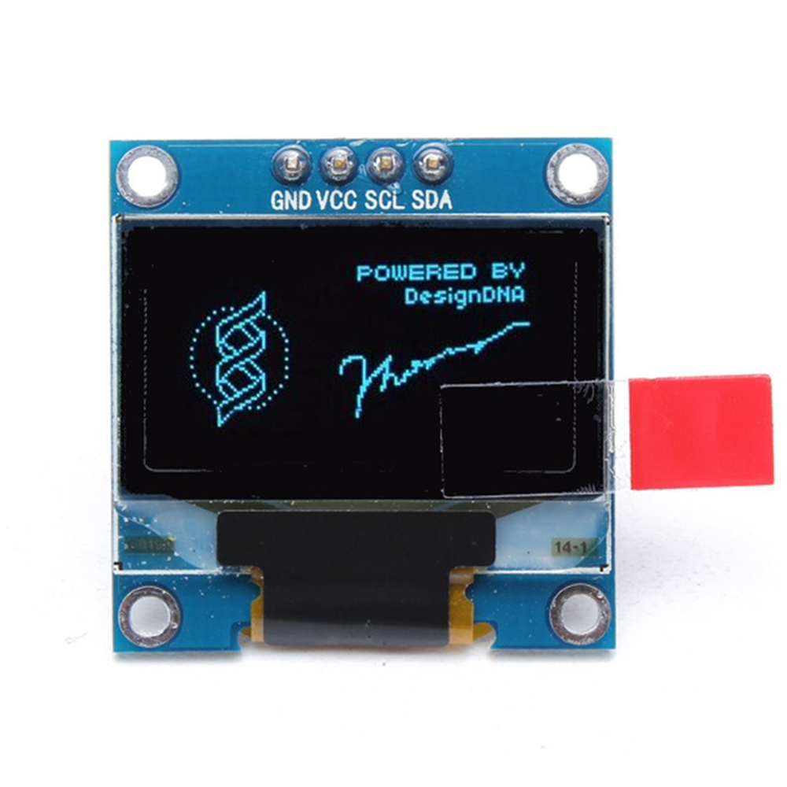

So many components

Slide 13
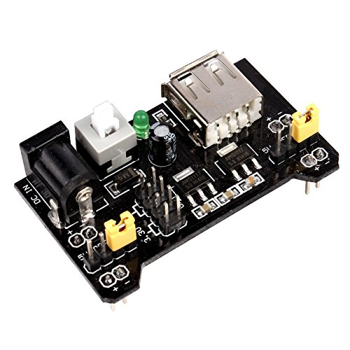
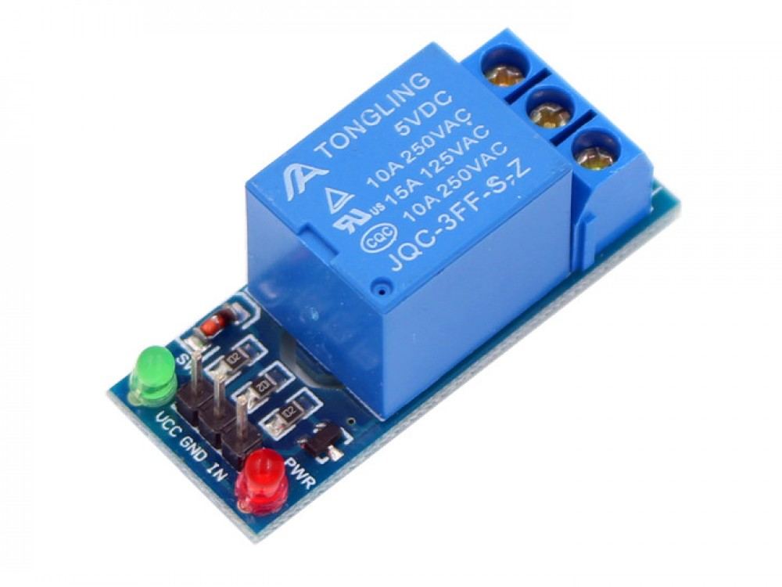
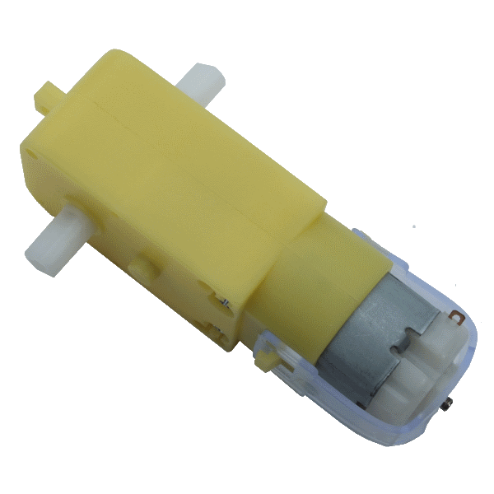
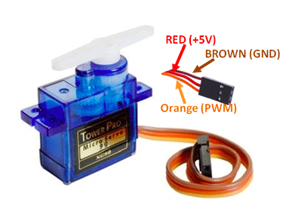
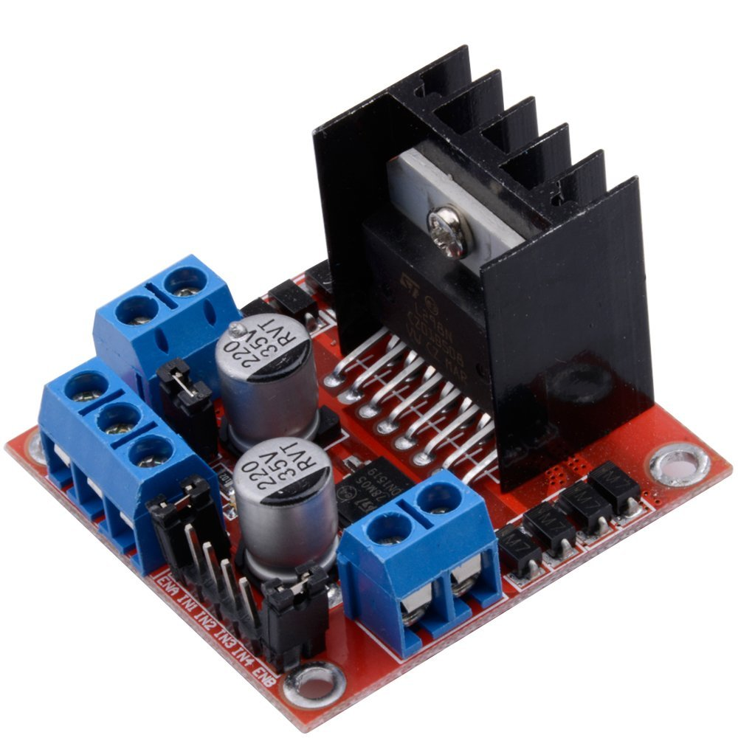
So many components

Slide 14
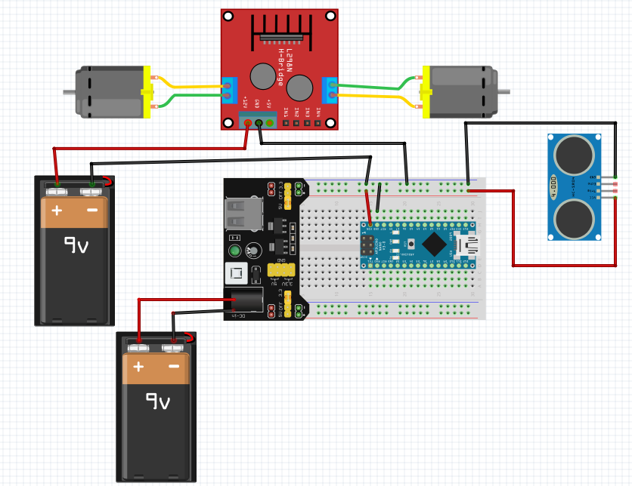
Power and Ground Connections

Slide 15
So far…..
So far ….
We have microcontrollers
BBC Microbit
Arduino Nono
WeMos D1
Motors
9V DC Motor
Servo Motor
Motor Drivers
L298
We have used various sensors
Touch Sensor
Ultrasonic Sensor
Light Detection Sensor
Sound Sensor
DHT11 Sensor
Pressure Sensor
Pollution Sensor
Display Technologies
OLED
LCD

Slide 16
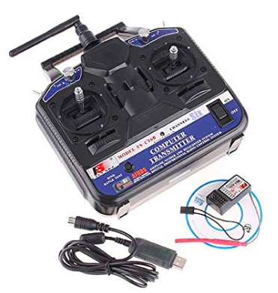
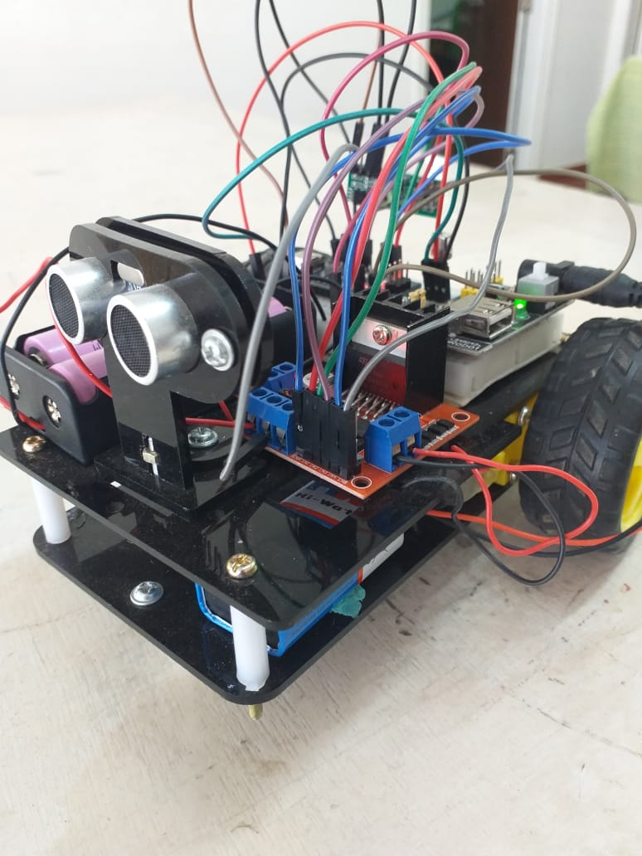
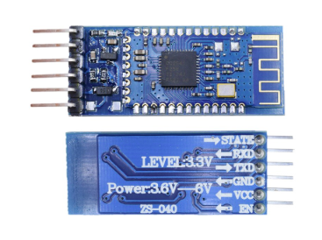
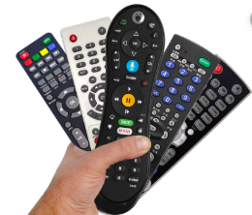
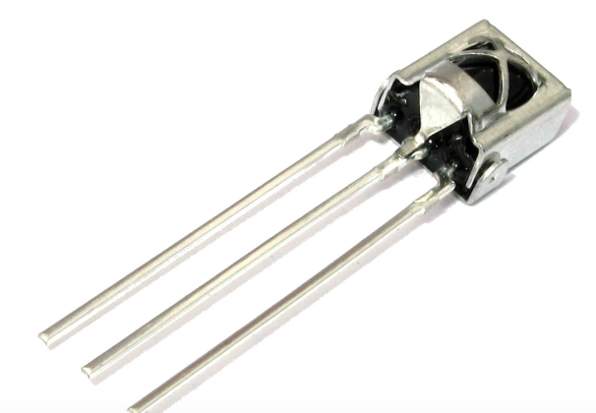
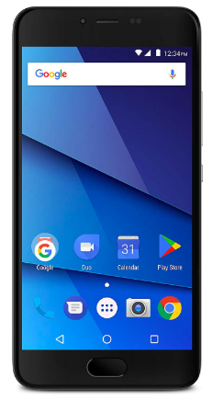
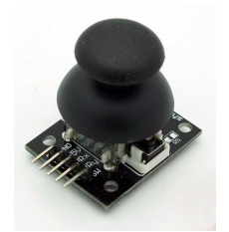
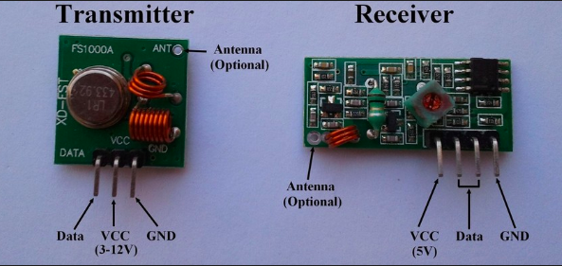
So far….
RF
IR
Bluetooth

Slide 17
So far ….
Communication Technologies
Infra Red (IR)
Radio Frequency (RF)
Bluetooth (iOS, Android)
Wifi
IoT
Prototypes
Lots of prototypes using all the sensors, displays, LEDs, Buzzers, Buttons, Breadboards, connecting wires, programming cables, Batteries, Key Pad, JoyStick, BreadBoard Power Supply Modules etc.
Our own car
Atonomous
IR, RF (with Joystick), KeyPad, Bluetooth, Voice, Wifi

Slide 18
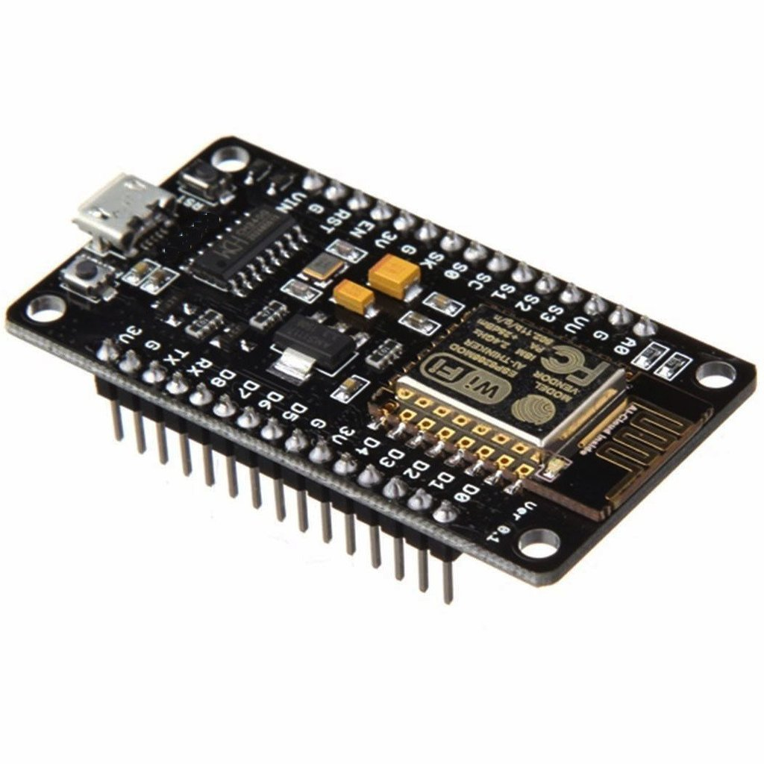
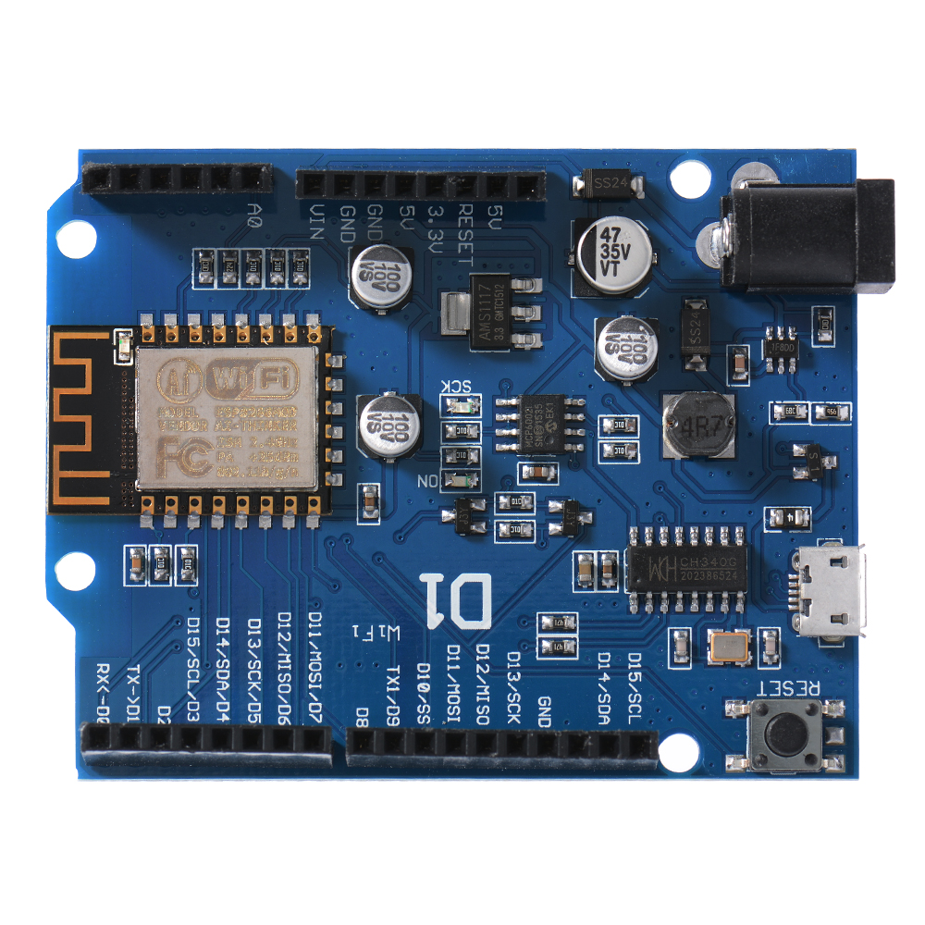
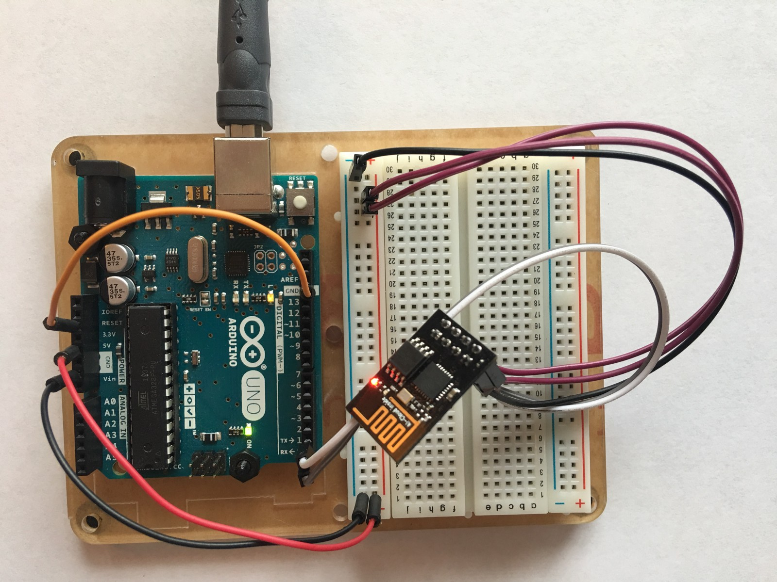
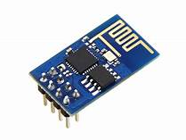
IoT
There are three ways to connect Arduino to wifi:
Using ESP8266 SOC Chip. ESP8266 is a low-cost wifi microchip with full TCP/IP stack for network connectivity
Arduino + ESP8266 Wifi module
Node MCU
WeMoS D1 - D1 board is compatible with Arduino UNO
Using ESP8266 wifi interface module
Arduino + ESP8266 wifi module.
Node MCU
ESP8266 wifi module
WeMoS D1

Slide 19
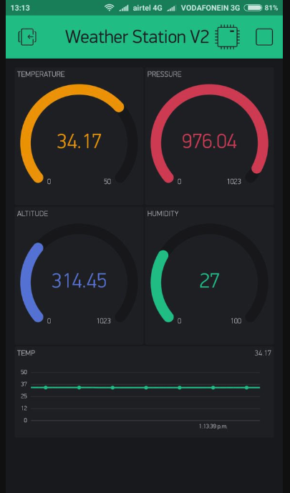
Blynk App
Create New Project
Choose Device -> ESP8266
Connection Type -> Wifi

Slide 20
Next Steps
Cloud Technologies and IoT
How to Build a Website
How to Build an APP
How to use cloud to connect all the devices

Slide 21
Next Steps
Deep Learning and Machine Learning
Autonomous Self–Driving Car
Detect the edge of the car
Detect the traffic signals
Given two set of coordinates it should navigate from A to B
Bit expensive kit (USD 250)

Slide 22
Next Steps
Drone Technologies
Autonomous Drones
Build & Navigate

Slide 23
Next Steps
Coding is the heart of all these new emerging technologies
Python
C/ C++

Slide 24
Internships
If you have anything specific / want to execute unique ideas…

Slide 25
Meanwhile …..
Weather Monitoring (Sreshta)
Tasks – (i) Normal prototype (Using Nano) (ii) IoT Prototype (Using WeMos D1)
Components - DHT, Pollution, BMP280, Buzzers, LEDs, OLED, Email, Notification Alerts
Home Security (Ved)
Tasks – (i) Normal prototype (Using Nano) (ii) IoT Prototype (Using WeMos D1)
Components - Touch Sensor, LDR, Ultrasonic, PIR, Buzzers, LEDs, OLED, Email, Notification Alerts
WiFi Controlled Car (Krish)
Tasks – (i) Gesture control car (Using accelerometer) (ii) IoT/ WiFi controlled car Prototype (Using WeMos D1)
Health Monitoring (Sana)
Tasks – (i) Normal prototype (Using Nano) (ii) IoT Prototype (Using WeMos D1)
Components - BPM, ECG Sensors, Buzzers, LEDs, Email, OLED, Notification Alerts
GITHUB ---- PUBLISH

